Slide 1
SEC555
Presentation based on SEC555: SIEM with Tactical Analytics
Tactical SIEM Design
Justin Henderson (GSE # 108)
@SecurityMapper

Slide 2

About Us
Author of SEC555: SIEM with Tactical Analytics
GIAC GSE # 108, Cyber Guardian Blue and Red
58 industry certifications (need to get a new hobby)
Two time NetWars Core tournament winner (offense)
And security hobbyist and community supporter
Collecting interns/contributors in bulk (research teams)
Release research to the community
See https://github.com/SMAPPER

Slide 3
Welcome!
More free stuff: https://github.com/HASecuritySolutions Disclaimer: This talk is NOT about bashing SIEM solutions or promoting one vendor/solution over others

Slide 4
Goal of this Webcast
Understand deficiencies in SIEM implementations
Getting the most out of your logs
Improve visibility into your organization
Create actionable detects
Use the attackers techniques against them
Tune your SIEM for tactical Analysis

Slide 5
SIEM Problem
Multiple organizations are struggling with SIEM
Slow performance
Lack of context and correlation
Raw logs lack analysis capabilities
Technology is not at fault (lots of awesome SIEM solutions)
Key deficiency is people
Lack of processes is a close runner up
SIEM failure is due to poor implementations and use cases

Slide 6

Hewlett Packard – State of Security Operations
Annual study measures maturity of organizations
Score ranges from 0 (no maturity) to 5 (full maturity)
Level of 3 is ideal for most enterprise SOCs
Scores broken down by people, processes, technology, and business integration
Five year overall average is 1.45
Lowest scores year after year are people and processes

Slide 7

Untraditional Log Collection
Where you spend your time specifies what you care about
90% log collection != efficient
Time needs to be spent on detection
Focus should be on tactical log collection
Automate, automate, and automate
And generate logs in a neutral and consistent way

Slide 8
NXLog AutoConfig
Overcomes log agent deficiencies and is a functional proof of concept
https://github.com/SMAPPER/NXLog-AutoConfig
Checks systems each day looking for components (IIS, etc)
If found, automatically configures for consistency
Or initial configuration…
Then sets up agent to start shipping logs
Use case organization spent lots of time managing agents

Slide 9

Traditional vs Network Extraction
Traditional
Network Extraction
Multiple collection points
Single collection point
DNS logs
SMTP logs
HTTP logs
DNS logs
SMTP logs
HTTP logs
Log Aggregator
Log Aggregator
agent
agent or syslog
agent or syslog
agent
DNS Server
SMTP Server
Web Proxy
Network
Extraction Sensor

Slide 10
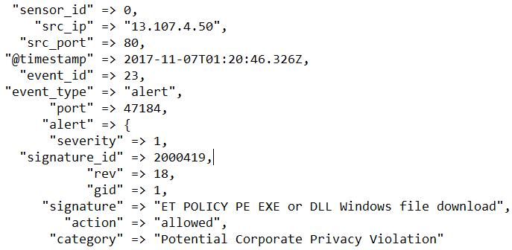
Traditional vs. Modern
Traditional - Syslog
Supported by almost everything
Easy to set up
Painful to parse
Must know fields ahead of time
Modern – JSON, XML, CSV, KV
Not always an option
Almost zero effort to parse
Don't have to know field names ahead of time
Nov 7 01:44:46 ubuntu-455 snort: [1:25385:3] EXPLOIT-KIT Multiple exploit kit Payload detection - calc.exe [Classification: A Network Trojan was detected] [Priority: 1] {TCP} 83.69.233.156:80 -> 10.0.2.15:1031
Or

Slide 11

Log Enrichment and Adding Context
Infrastructure Service Logs
Enrichment Techniques
DNS
HTTP
HTTPS
SMTP
Almost every network uses them
Lots of noise = lots of logs
Yet can be high value
Low value logs can morph into highly actionable detects
Baby Domains
Entropy Test (PH Imbalance)
Invalid Fields (wrong state)
Fuzzy Phishing

Slide 12
Ordinary to Extraordinary
query: www.google.com
query: www.google.com
subdomain: www
parent_domain: google
registered_domain: google.com
creation_date: 1997-09-15
tags: top-1m
geo.asn: Google Inc.
frequency_score: 18.2778256342
parent_domain_length: 6
Enriches to this

Slide 13
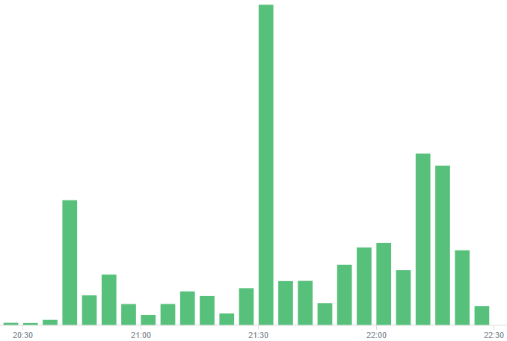
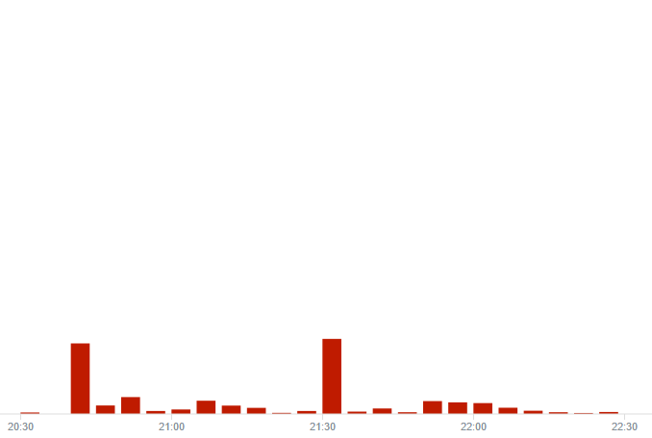
Top1M Filtering
Before
After - approx < 90% logs

Slide 14
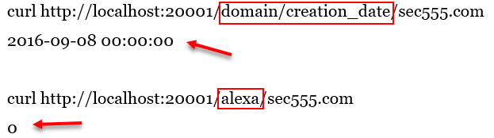
domain_stats.py
Mark Baggett developed domain_stats.py
Designed for speed and log analysis
Provides on mass domain analysis
Provides whois information like creation date
And top 1 million lookups (works with Alexa and Cisco)
Result
Result

Slide 15

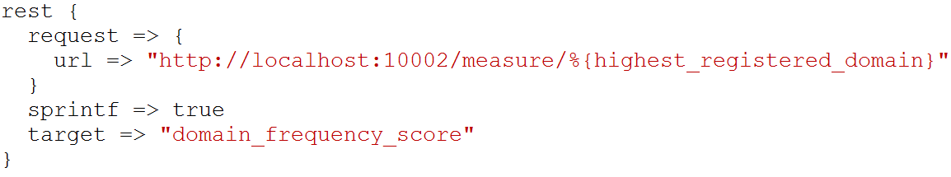
freq_server.py
freq_server.py is for large scale entropy tests
Created by Mark Baggett, author of SEC573
Manual testing
Logstash query

Slide 16

Fuzzy Phishing
Many SIEM techniques use insider information
Such as fuzzy phishing searches
Take legitimate company domains and look for variants
Extremely effective against phishing domains
Best used in combination with email alerts or scripts
Great for targeted attacks

Slide 17

Desktops Not Included
Today, client-side attacks are more common
Means the attack occurs at the desktop
Yet, cost of desktop logs is considered too high
If strategy is collect everything, it is true
If strategy is to stay nimble and tactical, it is more expensive not to log…
If desktops are main point of attack… you might need them

Slide 18
Collection Strategies – All Endpoints
Log All - 90% desktop
Targeted - 90% servers
Overwhelming amount of logs
Significantly less logs (> 80% reduction)
Desktops
Servers
Servers
Desktops

Slide 19
Tactical vs. Total
All inclusive
Tactical
Desktops
Servers
Servers
Desktops

Slide 20
Endpoint Analytics
Endpoint logs are incredibly powerful yet underutilized
Too much emphasis on “insert security product here”
Not enough visibility on desktops/laptops
Endpoint logs can readily be operationalized
Strategies such as below can be used to detect attacks using
Long command lines
Unauthorized service creations
Malicious PowerShell use
Internal Pivoting
Brute force logins
Whitelist evasion

Slide 21
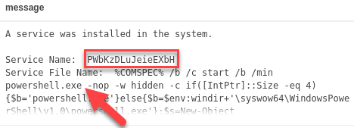
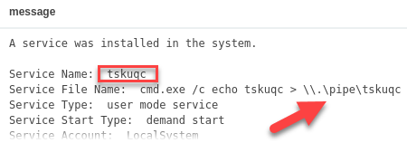
Service Creation Gone Bad (Event ID: 7045)
Common attack techniques create services
Top example is of Meterpreter compromise through PSExec
Bottom event is of privilege escalation

Slide 22
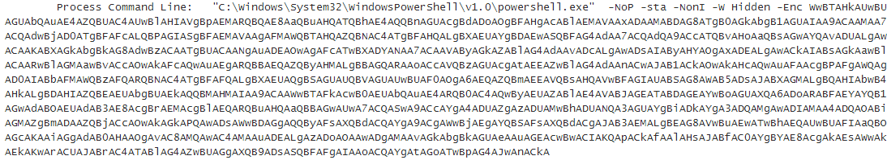
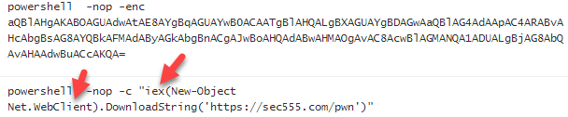
PowerShell Attacks (Event ID: 4104 or 4688)
PowerShell is now commonly used for modern attacks

Slide 23
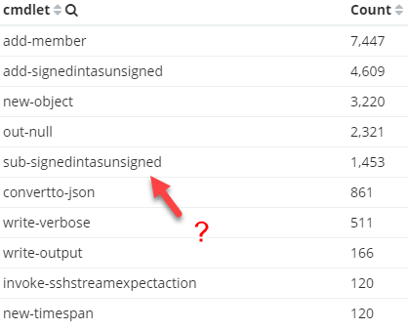
PowerShell Whitelist Detection
PowerShell version 5 logs contain name of cmdlets
Export from trusted systems
Use as whitelist of cmdlets
Then alert on anything new
Can be expanded to include
Parameters
Users
Systems

Slide 24
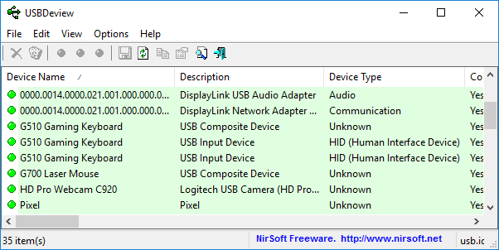
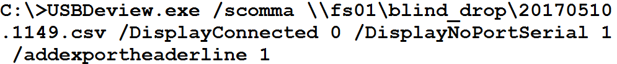
NirSoft USBDeview¹
Simplification is acceptable/preferred
Possible to run 3rd party tool once a day and log to file
Better late than never

Slide 25
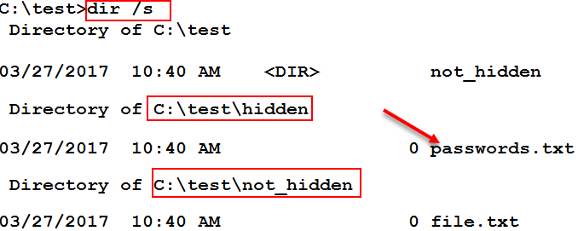
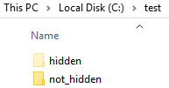
File Auditing (Event ID 4663)
Automated scripts/malware often used to find patterns
Social security #, credit card #, or drivers license
Operate by enumerating and reading through files
Often ignores hidden folders

Slide 26
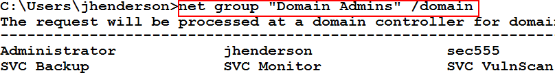
Group Querying (Event ID 4662 and 4663)
By default all users can list group members
Attackers enumerate members to find users to target
Many alternative methods to list group members
Mickey Perre has a blog on detecting this behavior
Windows auditing can capture read member requests
Combined with agent/aggregator filters = AWESOME

Slide 27
HALO (Honeytokens Against Leveraging OSINT)
Fake users can be created publicly to combat recon
Could be just in hidden metadata and/or key public sites
Example: Peter Parker(pparker@sec555.com)
On LinkedIn, Facebook, Adobe, PGP, Github, etc.
Likely to be picked up during OSINT
Eventually may make compromised account lists
Takes minimal time to setup… can get fairly elaborate
Activity from this account is malicious and provides context

Slide 28
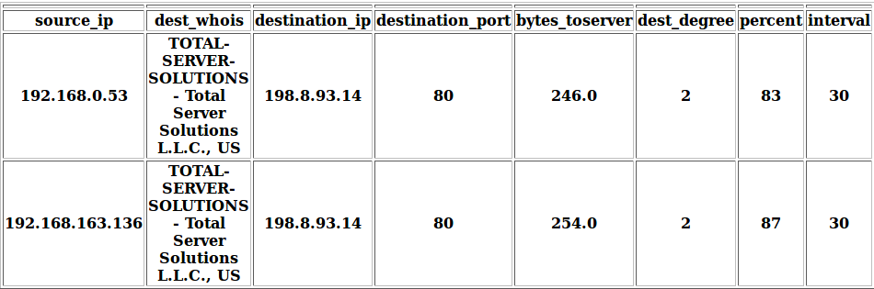

Flare
Austin Taylor wrote a beacon discovery script called Flare
Uses Elasticsearch to crawl historical connections
Identifies connections with consistent beaconing
Supports analysis of custom time periods
Additional capabilities being baked in

